Slide 1
Greenfield AgriCo market entry and case for change in Southeast Asia
March 2025
Urban Farming Strategy

Slide 2
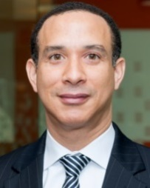









For questions related to this document please contact any one of our team members
Sarah Chen
Engagement Partner
Singapore sarah.chen @strategyand.sg.pwc.com
Marcus Rivera
Subject Matter Expert
Australia marcus.rivera @strategyand.au.pwc.com
Priya Sharma
Engagement Director
Singapore priya.sharma @strategyand.sg.pwc.com
James Wong
Client Relationship Manager
Singapore james.wong @sg.pwc.com
Rachel Lim
Engagement Manager
Singapore
rachel.lim @strategyand.sg.pwc.com
David Tan
Work Stream Lead
Malaysia david.tan @strategyand.my.pwc.com
Lisa Ng
Work Stream Lead
Singapore
lisa.ng
@strategyand.sg.pwc.com
Amir Hassan
Work Stream Lead
Malaysia amir.hassan @strategyand.my.pwc.com
Kevin Park
Analyst
Singapore kevin.park @strategyand.sg.pwc.com
Emma Lee
Analyst
Singapore emma.lee
@strategyand.sg.pwc.com

Slide 3
Project Qualification: Urban Farming Strategy for an AgriCo in South East Asia
Situation | Actions | Results achieved
Clients Government statutory bodies in charge of national food security and agricultural development Situation Client required support to establish an AgriCo focused on urban farming to advance the nation’s food security agenda Seeks assistance in devising the company’s value proposition, farm network architecture, target operating model, investment case, corporate structure, and implementation plan | How Strategy& helped Identified emerging trends in the country’s agriculture landscape and performed competitor analysis Conceptualised solutions and offerings of AgriCo to address current gaps in the local food supply market Developed the high level business model, which includes target customer segments, supply chain journeys and adoption levers Determined the target operating model; identified core functions required for AgriCo Assessed joint-venture corporate structure options for AgriCo, including legal and board structure Devised the implementation roadmap, including considerations for go-live models, go-to-market strategy, joint-venture partner selection, and stakeholder management Developed case studies of global urban farming leaders in order to aid decision-making for the Clients | Delivered a high level blueprint to establish an urban farming AgriCo Outcome will be presented to the ministry of sustainability and food security in the country

Slide 4
In support of country's Smart Food Security agenda, client aims to establish an AgriCo to further drive urban farming adoption
Country Food Security Target
Clients Objectives
Interoperable farming system
Simple distribution network
Faster harvest cycles
Safer produce standards
Develop a national urban farming solution through AgriCo that aims to:
Promote vertical farming for retail and restaurant supply chains
Support food banks and the social sector
Establish a forward-looking view (including emerging and key trends) of the agriculture landscape
Determine the ways-to-play (incl. op model, target markets) for AgriCo to accelerate adoption of local produce
Design infrastructure that is future ready by exploring all relevant current and potential technologies – assess suitability of existing national farming infrastructure
Explore opportunities to leverage on existing investments for the collaboration
Higher accessibility and acceptance for consumers and businesses
A simplified distribution system to increase competitiveness and efficiency for users
Increased speed of harvest-to-table via controlled environment agriculture
A fully regulated food safety environment (e.g. establishment of the Food Standards Council)

Slide 5












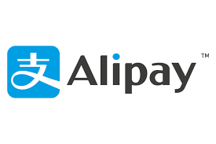
In response to top-down call to action, disruptors are entering the market with two variations of urban farming propositions
Farming models available
Indoor Vertical Farms
Rooftop Greenhouses
Community Gardens (or more)
Produce grown and distributed directly by operator to consumer
Operators grow and distribute produce. Distribution is dependent on a specific network and delivery arrangement
Operators only grow produce. Distribution is broadly accepted via existing wholesale and retail supply chains
Grower/Distributor
Grower
Distributor
Consumer
Merchant
Consumer
Merchant
Consumer
Merchant
Operators:
Operators:
Operators:
Recently opened to third party growers
Closed-loop farms
(Controlled env.)
Open farms (Multi-crop)
1
2
Source: AgriTech Asia, PwC Strategy& analysis

Slide 6
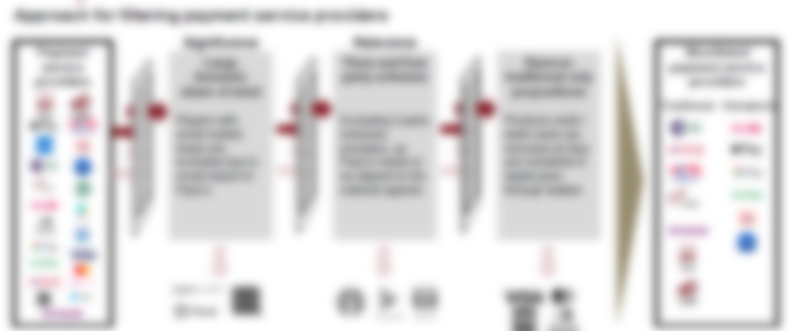
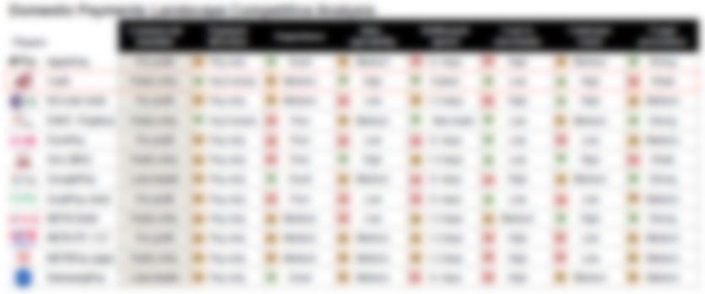
While disruptors bring choice for consumers, 'Imported Produce' remains the leading option for affordable food
Competitor Landscape Analysis
Operators were assessed across seven lenses – produce variety, freshness, interoperability, harvest speed, cost to merchants, customer reach, and food safety
The urban farming operators selected for assessment were filtered based on their significance in the market

Slide 7





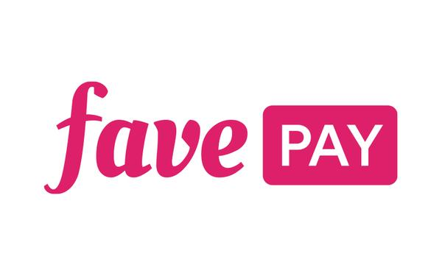

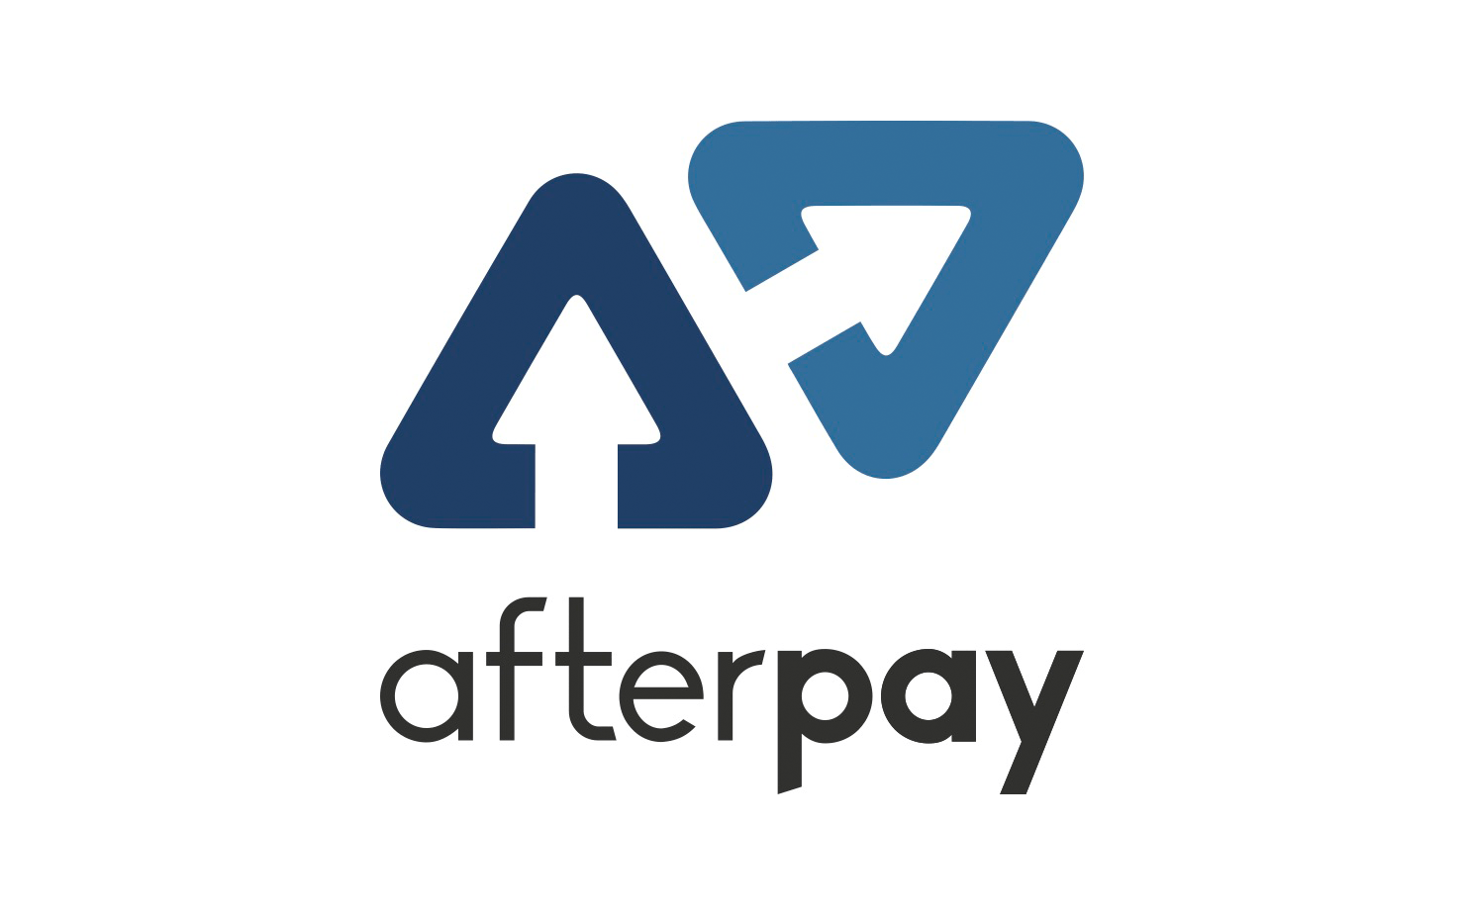

Non-differentiating efforts by players often reap marginal benefits as consumer pain points remain unaddressed
Differentiating efforts of players
Description
Tech-led vertical farms
Technology-driven farming solutions available (app-based) to consumers upon subscription. The platform allows for B2C and B2B produce ordering
Key takeaway
Consumer experience is compromised as operators try to diversify and differentiate themselves
Consumers often have to travel to specific locations or wait for delivery windows (inconvenient)
Interoperability is still lacking as produce offerings are limited to specific operator networks and restricted to pre-approved merchants
Lack of quality standards and traceability measures result in spoilage and waste – business model becomes unsustainable
Retailer co-branded farms
Co-branded farms are collaborative efforts by a retailer and a farm operator to provide fresh produce directly in-store, usually aimed to drive shared customer loyalty
Disruptive farm-to-table play
Disruptors enter the farming landscape with intentions to maximise direct-to-consumer freshness to support core business. Discounts and incentives are offered frequently to consumers
Sustenir Agri
Subscription harvest services
Operators are providing a subscription harvest service that allows consumers to pre-order seasonal produce and receive regular deliveries, assisting consumers with fresh food access
Reduction in costs to consumers
Operators are expected to reduce distribution margins in order to remain competitive and encourage merchant adoption (e.g. SkyGreens have reduced margins for some merchants to 5% per kg from 20%)
SkyGreens
Source: Company websites, Straits Times, PwC Strategy& analysis

Slide 8

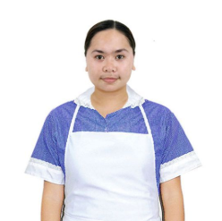
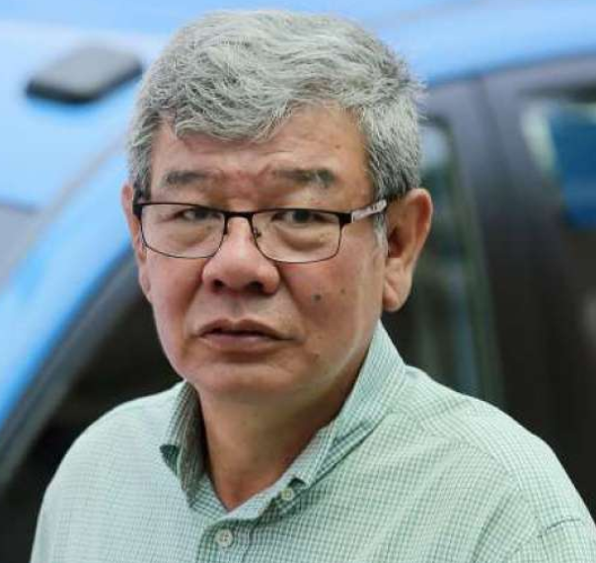




The country's grassroots still prefer imported produce especially for daily meals – a habit entrenched in hearts and minds
Dominant Sourcing Mode: A Household's Perspective
Pioneer (>65 years)
Imported produce is a norm in every household as it is affordable, available, familiar, and widely stocked
Buys groceries for daily meals – wet market, supermarket, hawker centres
Buys only imported produce due to familiarity and lower price
Foreign Worker (20 – 44 years)
Buys only when requested by employer, mostly household groceries
Buys imported produce as it is the usual option provided by the employer
Receives food allowance and sends savings home to family physically
Yeo Soo Keng, 78
Silver Hair (45 – 65 years)
Maria, 35
Provides for family, buys groceries and meals from markets
Buys imported produce or visits supermarket chains
Prefers imported produce for daily cooking needs
Tan Chun Kit, 58
Goh King Kuan, 50
Teen and Young (<19 years)
Young Adult (20 – 44 years)
Eats meals prepared by parents using mostly imported ingredients
Buys snacks and meals using pocket money at hawker centres and convenience stores
Buys groceries for meals, dining out, and retail food shopping
Buys imported produce, occasionally tries local organic options
Open to local produce, prefers imported for affordability
Daniel Tan, 26
Marc Tan, 18
Becky Tan, 12
Source: PwC Strategy& analysis

Slide 9
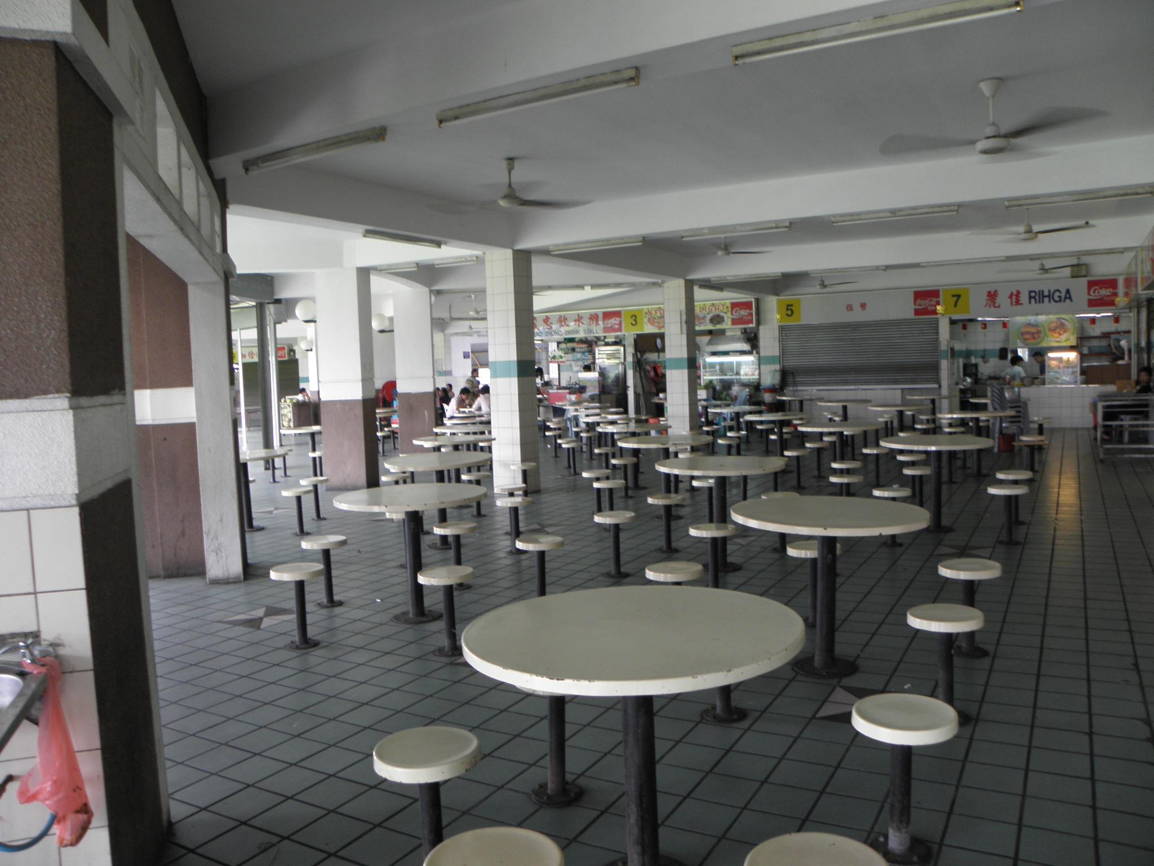
From a small merchant perspective, hawkers prefer imported ingredients due to their affordability and wide availability
Needs:
Affordability
Availability
Reliability of Supply
Day-in-life of a Hawker – Overview
Suppliers:
Chun Kit has to go to the wet market early morning to source his ingredients for the day's cooking
His suppliers stock mainly imported produce as it is cheaper and more readily available
Operations:
Chun Kit's busiest hours are between 12pm to 2pm. He serves ~90 bowls of fish soup during that period at ~$4 each
A small % of customers asks about locally-farmed ingredients but are satisfied with the taste of imported produce
Morning
Import Supply Cycle
Mid-day
Tan Chun Kit, 58
Tan Chun Kit, 58 years old, is a hawker selling fish soup. He employs 1 stall assistant and operates between 7.30am – 4.30pm. Imported ingredients are his dominant source of supply.
Chun Kit is the primary breadwinner of his family, which consists of his wife and 2 sons who are still in school. He currently lives in a 3-room flat.
Evening
Family:
After Chun Kit closes his stall for the day, he goes to a nearby food centre to pack food for his family – imported produce is the main ingredient used in the food centre
Chun Kit's sons ask him for dinner money after school for a meal at the hawker centre – imported ingredients are the most affordable and convenient option for hawkers

Slide 10
Example: Imported and locally-farmed produce are about cost neutral to hawkers – no compelling incentive to adopt local farming
ILLUSTRATIVE
Case Study: Cost of Imported vs. Locally-Farmed Produce
Scenario 1: Imported Only
1 hour
Cost of Import Sourcing
Sourcing
Quality Check
Market Trip
1 hour per day of quality check and market trip
$10 per hour opportunity cost to Chun Kit1
365 days of operation per year
Chun Kit only sources imported ingredients – spending $80 per day on produce for 140 bowls of fish soup
End of day, Chun Kit inspects the remaining stock, estimating wastage against the day's usage
Chun Kit travels to the wet market to restock imported ingredients for the next day, spending 1 hour for quality check and restocking
Opportunity cost per annum: $3,650
Avg. impact to profitability4: ~5%
Scenario 2: Locally-Farmed Only
20 mins
Cost of Local Produce
Sourcing
Quality Check
Home
~$200,000 revenue per year2
5% – 15% premium per kg for local produce3
20 mins per day at $10 per hour1
Chun Kit sources locally-farmed ingredients for all 140 bowls of fish soup everyday, incurring 5% - 15% price premium per kg
End of day, Chun Kit performs a quick freshness check to ensure produce received matches quality standards
Chun Kit goes home and his work is done for the day
Avg. annual premium: $4,900
Avg. impact to profitability4: ~6%
Note: 1) Hourly opportunity cost is based on average per hour wage adjusted for realisable savings amount of $10; 2) ~$200,000 revenue per year is based on $560 revenue per day multiplied by 365 operational days per year; 3) Price premium range is based on competitive rates – local farms (5%) to certified organic (15%); 4) Profitability is assumed to be 40% of revenue at $80,000 based on average gross margins for hawkers
Source: AVA; PwC Strategy& analysis

Slide 11

In order to encourage local produce adoption, the import dependency cycle needs to be broken without affecting family needs
Current State Supply Cycle – Import-Based
Future State
3
Soo Keng receives groceries from Chun Kit and prepares daily meals using imported ingredients – vegetables, meat, and some household staples
2
Local produce adoption can be facilitated by breaking the import cycle simultaneously, increasing overall local food supply
Chun Kit receives produce directly from the AgriCo network without needing a physical wet market trip
Produce is distributed directly to Soo Keng, Marc, and Maria via local delivery networks
As local farming becomes widely adopted, Soo Keng, Marc, and Maria can source fresh produce locally without relying on imports
1
Yeo Soo Keng, 78
Tan Chun Kit, 58
Marc receives meal money from Chun Kit and eats at hawker centres using imported ingredients – meals, snacks, entertainment
1
Chun Kit sources ingredients through the wet market supply chain. He proceeds to the market early morning to:
Buy groceries for his mother, Soo Keng, and son, Marc
Provide food supplies for his household helper, Maria
Marc Tan, 18
2
Maria receives groceries and proceeds to the nearest convenience store to buy additional household items for the family
3
Maria, 35
Source: PwC Strategy& analysis

Slide 12

There are five key needs of new urban farming offering that will appeal to the People and beyond
NON-EXHAUSTIVE
Consumer Facing Produce Example Use Cases
Produce Category
Supply Flow
Distribution Channel
Market Situation
Consumer Needs
Fresh produce delivery
Delivery via local farms, online platforms, or neighbourhood collection points – wide range of channels
Underserved – market fragmented with noise
Fresh
Widely available
Traceable (e-label)
Restaurant supply
Sanitised
Produce supplied via wholesale – fragmented and lengthy distribution process
Underserved – lack of direct farm-to-govt offering
Fresh
Traceable
School meals
Produce sourcing mostly done via importers, emerging offerings with local farms
Underserved – infra available, but poor experience
Fresh
Simple and convenient
Traceability
Govt food programs
Sanitised
Produce sourced via govt tenders – complex process with administrative requirements
Underserved – lack of simple and direct farm-to-community offering
Fresh
Simple and convenient
Community distribution
Sanitised
Produce distributed via community centres, increasingly using local networks – limited experience
Underserved – lack of direct community distribution offering
Fresh
Traceable
Source: PwC Strategy& analysis

Slide 13
AgriCo aims to provide a unified farming infrastructure; it is not a supermarket, distributor, or “another” farm
Key Functions of AgriCo
AgriCo is …
AgriCo is not …
An interoperable produce sourcing experience
Allow buyers to source produce across a wide range of categories (e.g. vegetables, herbs, protein, specialty crops), based on unique identifiers (e.g. farm ID, batch number, crop variety)
A common standard for interoperable farming
A produce distribution processing service
Facilitate and authenticate produce transactions between farm network users
A merchant services offering
Offer solutions to support day-to-day merchant sourcing and operational needs, digitising food businesses
A supermarket
AgriCo will not provide retail services to consumers (e.g. branded stores, consumer shelf space, etc.)
A cold-chain distributor
AgriCo will not perform functions of a logistics and cold-chain distribution facility (e.g. require license from food authority)
“Another” farm in the market
AgriCo will not add to the market fragmentation of urban farms in the country but rather to unify existing farming offerings
Source: PwC Strategy& analysis

Slide 14





AgriCo operates Farm Network and Distribution Platform, supported by merchant services and a standards arm
AgriCo's Lines of Service
Core Services
Enablers
Farm Network
Distribution
Merchant Services
Standards
1
2
3
4
Enables multiple category produce lines (i.e. first and third party farms) and 'Produce-on-demand' / pre-order transactions
Ensures interoperability between all participating entities for a wide range of produce categories (e.g. vegetables, herbs, protein, specialty crops)
Facilitates and authenticates produce distribution transactions
Enables order processing, fulfilment, and settlement for distribution service users
Sets and enforces distribution operating rules (e.g. quality management, freshness requirements)
Provides merchants with solutions that cater to day-to-day sourcing needs, including but not limited to:
e-ordering and invoicing
Auto inventory tracking
Supplier and quality management
Freshness monitoring
Sets quality standard required for service users to participate in Farm Network
Determines standard required for interoperability
Leads initiatives to educate and shift public mindset to increase local produce adoption
Source: PwC Strategy& analysis

Slide 15

The Farm Network is a unified platform that allows users to access multiple produce categories, promoting interoperability
ILLUSTRATIVE
Overview of Farm Network
Farm Network is a unified platform / 'Produce-on-demand' that enables users to access multiple produce categories, promoting interoperability and reducing fragmentation of food supply in the country
Vegetables
Who does it serve?
Service users (i.e. produce category providers) who compete on freshness and variety on their respective platforms (e.g. farm-to-table, organic certification)
Consumers who want to access fresh local produce across a wide range of categories and distribution channels
Herbs
Protein
How does it work?
Produce category providers register to participate in Farm Network to enhance their respective distribution with wide access and interoperability
Consumers browse their preferred produce categories on the Farm Network platform (e.g. vegetables, herbs, protein, specialty crops)
Consumers select the most preferred source of produce to complete an order (e.g. organic greens from a vertical farm)
Consumers receive produce (direct delivery or collection) through mode offered by merchants (e.g. neighbourhood pickup, home delivery, market stall), enabled by 'Produce-on-demand'
1
Specialty
2
3
Farm Network
4
Source: PwC Strategy& analysis

Slide 16
AgriCo will allow 3rd party producers to participate in an open distribution scheme
ILLUSTRATIVE
Overview of Distribution
Distribution facilitates and authenticates produce orders, enables processing, fulfilment, and settlement services, as well as sets and enforces distribution operating rules
1
Service User
Herbs
Protein
Vegetables
Specialty
Who does it serve?
Service users (i.e. produce category providers) who want to leverage on AgriCo's digital infrastructure to achieve interoperability, extend customer reach, and distribution experience
2
How does it work?
Service user integrates and joins the distribution platform to leverage on the digital infrastructure provided by AgriCo
Interface facilitates all orders processed by service users within the distribution network
Enables fulfilment and settlement services – potentially leverage on existing cold-chain infrastructure
Interface
1
3
2
3
Fulfilment & Settlement
AgriCo Distribution
Source: PwC Strategy& analysis

Slide 17
Merchants could leverage on AgriCo's digital solutions to support day-to-day sourcing and operational needs
ILLUSTRATIVE
Overview of Merchant Services
Merchant services enable overlay digital solutions that cater to merchants' day-to-day sourcing and operational needs
Who does it serve?
Merchants, onboarded by AgriCo, who want to digitise their sourcing and business operations, enabling operational efficiency (e.g. e-ordering and invoicing, auto inventory tracking, supplier management, freshness monitoring, reporting and analytics)
How does it work?
Merchants adopt AgriCo's offering, sourcing most or all produce via AgriCo's network
Merchants leverage on AgriCo to enable digital sourcing solutions to support business operations
AgriCo enables and integrates selected digital solutions for merchants
1
2
Merchant Services – Overlay Digital Solutions
3
Source: PwC Strategy& analysis

Slide 18
Standards set requirements for Farm Network and Distribution to drive quality and traceability for consumers and merchants
ILLUSTRATIVE
Overview of Standards
Standards set technical, quality, and operational requirements for Farm Network service users, determines and enforces distribution rules, as well as boost consumer and merchant adoption
Who does it relate to?
Farm Network service user (i.e. produce category providers) – subjected to farming standards
Distribution service user – subjected to distribution rules
AgriCo's consumers and merchants
How does it work?
Farm Network service user must meet the set technical, quality, and operational requirements to participate in Farm Network
Distribution service user must adhere to distribution rules set by AgriCo
AgriCo's offering to align to formal and informal consumer and merchant adoption levers to change public mindset and behavior towards local produce
AgriCo Standards
Source: PwC Strategy& analysis

Slide 19
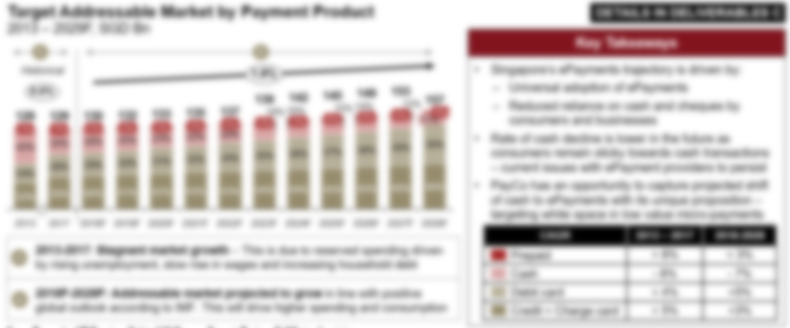
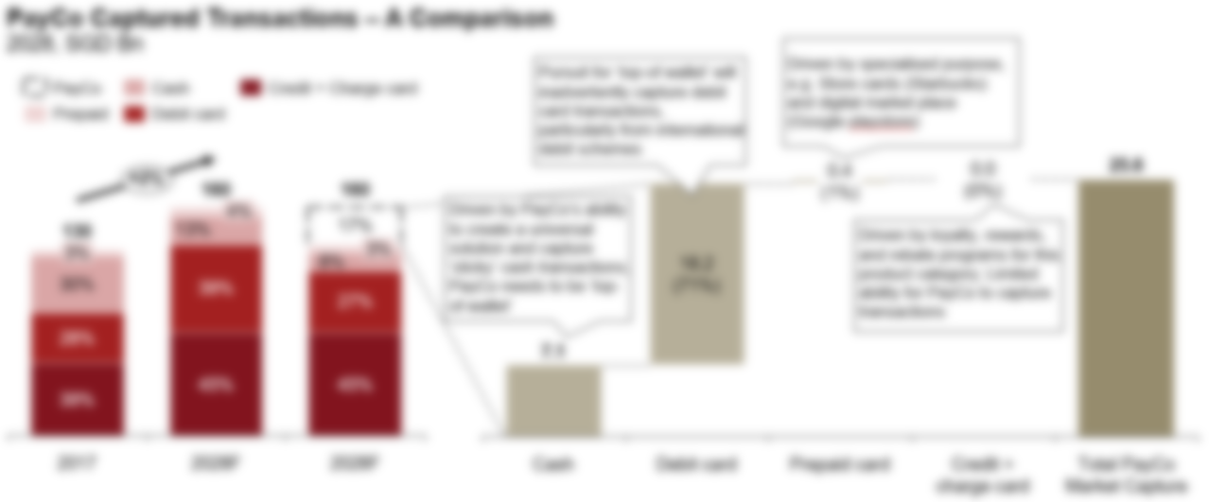
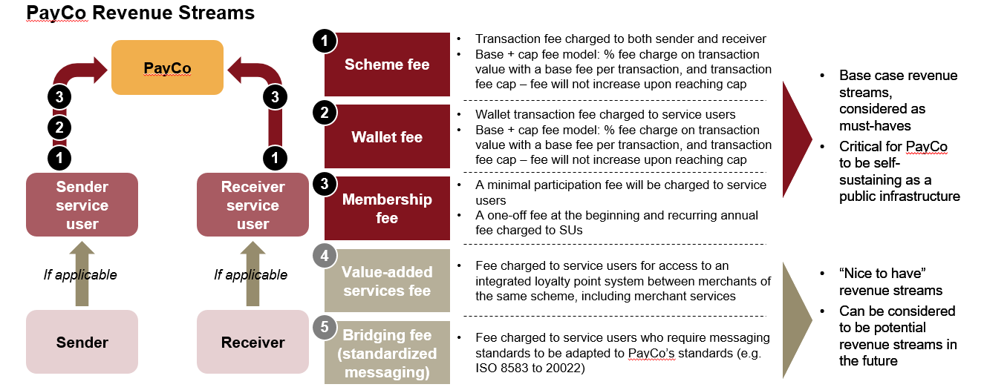
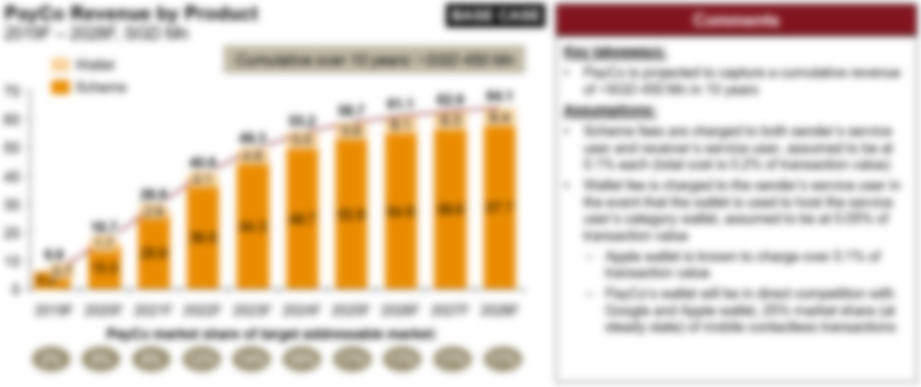
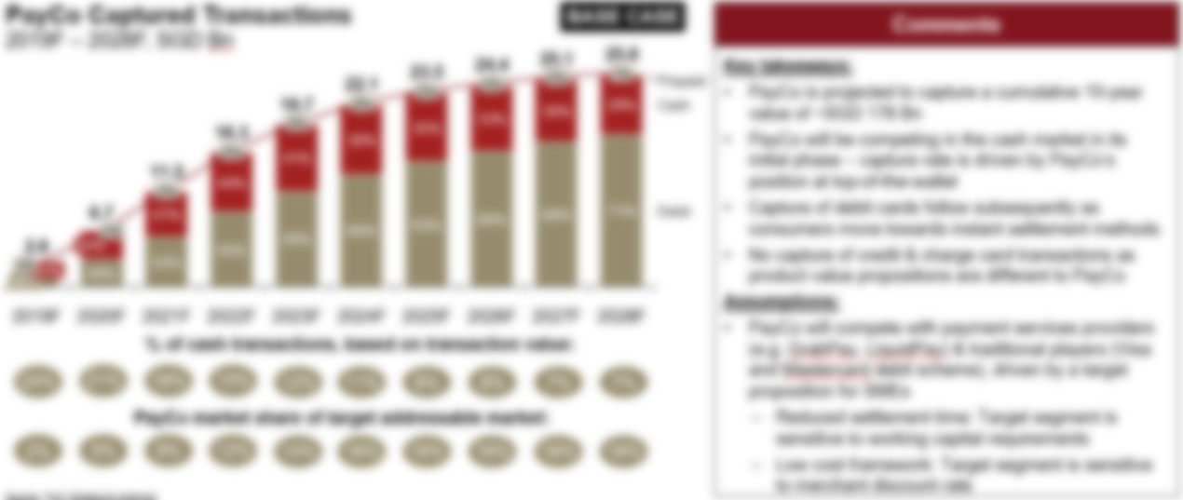
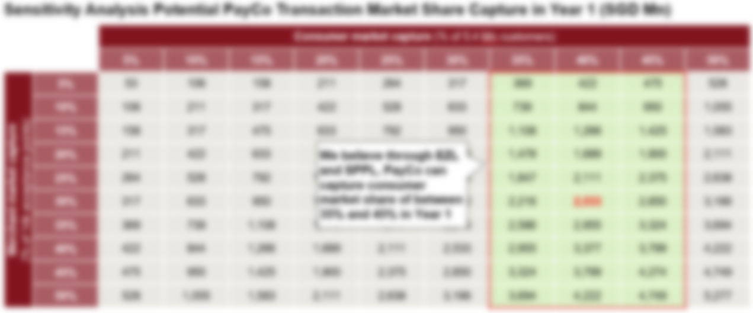
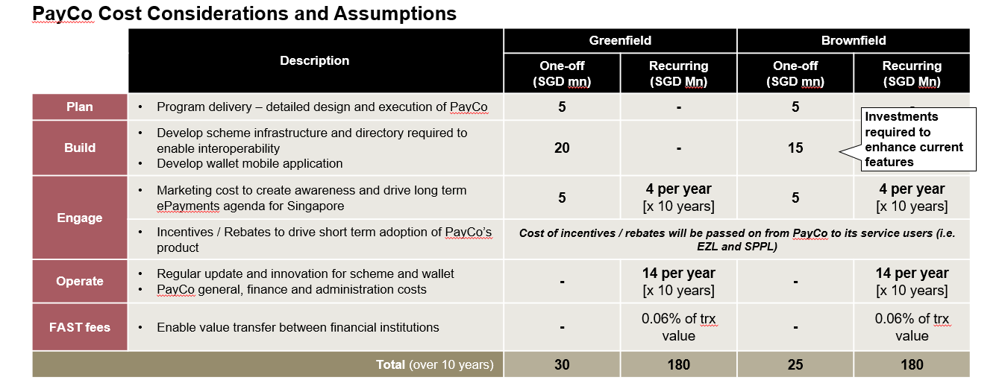
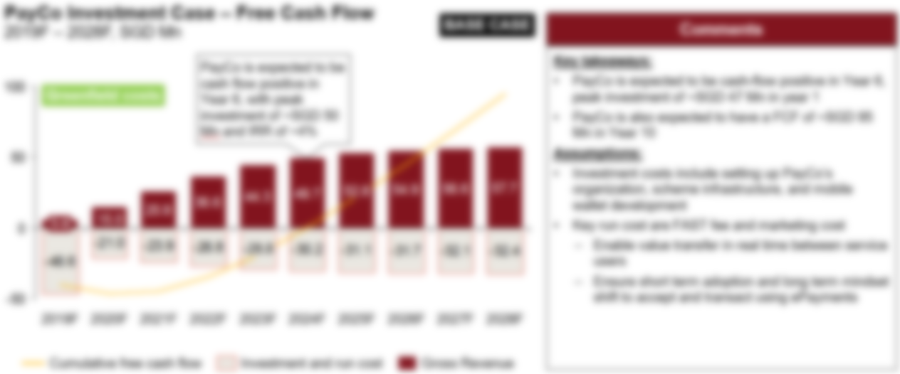
The target addressable market for AgriCo was identified and business case developed to substantiate the investment required
Overview of the Target Addressable Market
Overview of the Business Case
Key Takeaways
AgriCo will be competing in the imported produce market in its initial phase – capture rate is driven by AgriCo's interoperability feature and its position as the top-of-mind local produce platform
AgriCo will capture wholesale fresh produce transactions subsequently as merchants move from imported to locally-sourced ingredients
Specialty and premium import transactions will not be captured by AgriCo as they offer consumers a different product proposition to AgriCo, competing in a different market
Key Takeaways
As a national infrastructure, AgriCo's fees to service users will be lower than local and international produce distributors – main revenue lines include the farm network, distribution and membership fee
AgriCo Farm Network will be in direct competition with imported produce distributors and emerging AgriTech platforms at steady state
AgriCo's cost buckets are categorised into Plan, Build, Engage, Operate and Change – largest in Build as capital is required to develop the farm network infrastructure and directory required to enable interoperability

Slide 20
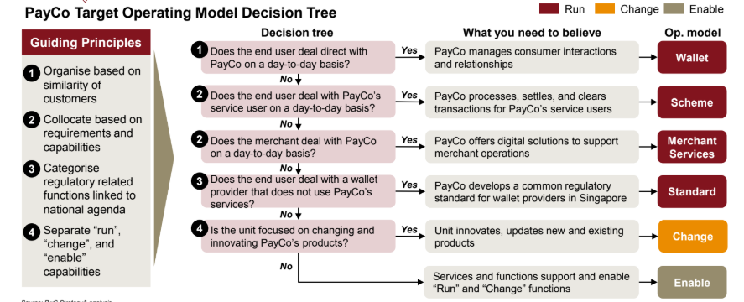
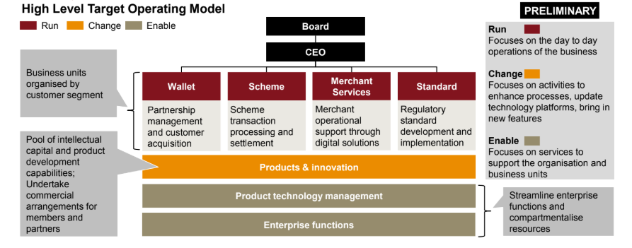
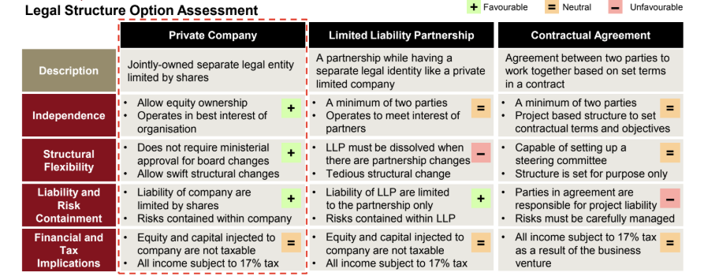
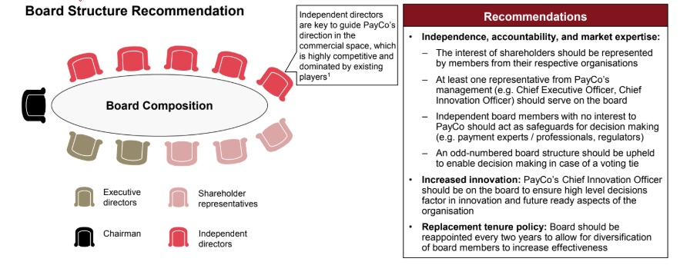
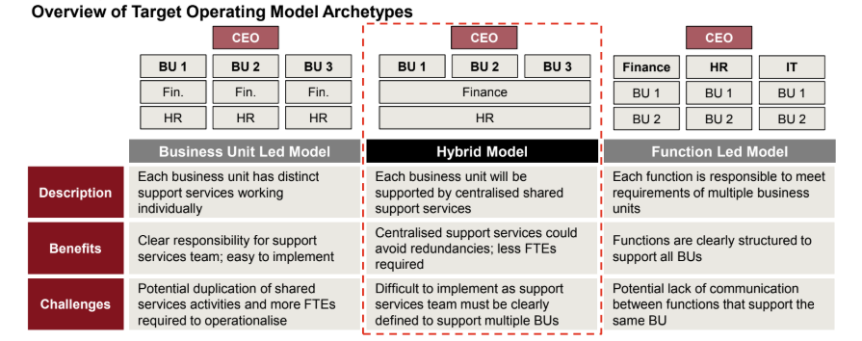
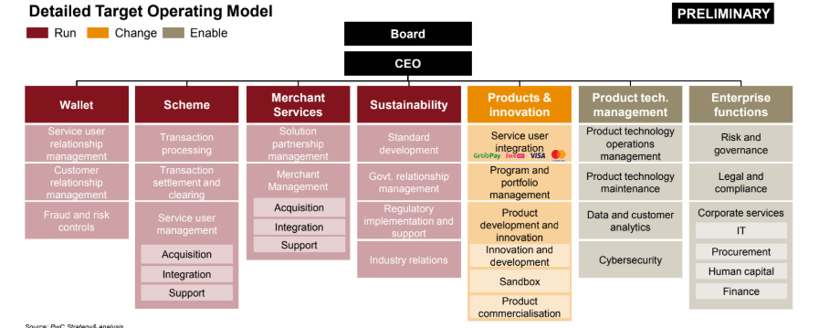
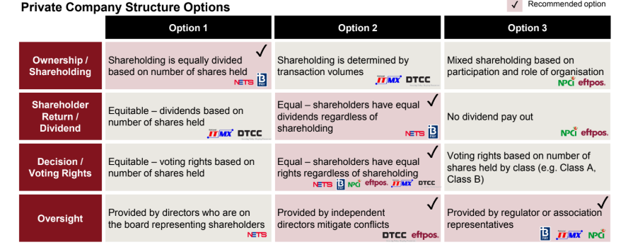
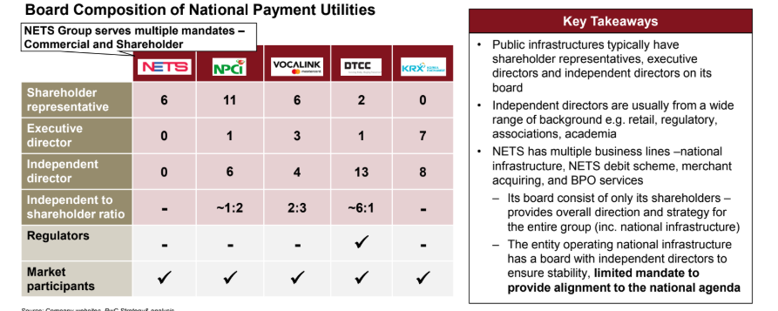
AgriCo's operating model and corporate structure were developed in order to maximise synergies between the Clients
Overview of the Operating Model
Overview of the Corporate Structure
Key Takeaways
A hybrid (cross) model of a Business Unit-led and Functions-led operating model is recommended for AgriCo as support services are centralised and redundancies are avoided
AgriCo's target operating model is aimed to be lean and equipped with essential “run” function for AgriCo's service offering, “change” function for products and innovation, and “enable” function for farm technology management and enterprise functions
Key Takeaways
AgriCo is recommended to be a private company as it allows for independence, swift changes without ministerial approvals, and limited risks for AgriCo
As a public infrastructure, AgriCo's Board of Directors will include a chairman, executive directors, shareholder representatives and independent board members from various backgrounds to uphold unbiased decision making

Slide 21
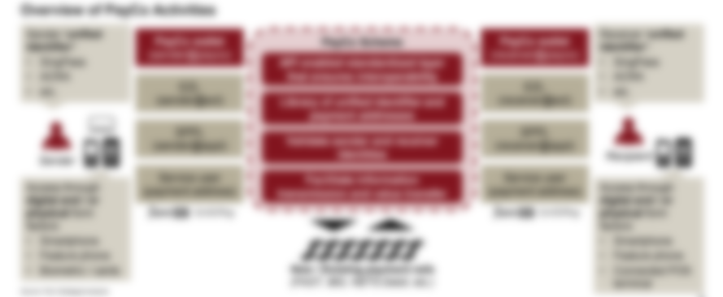
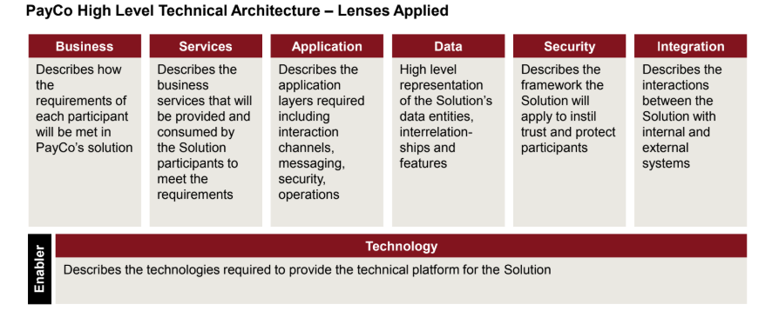
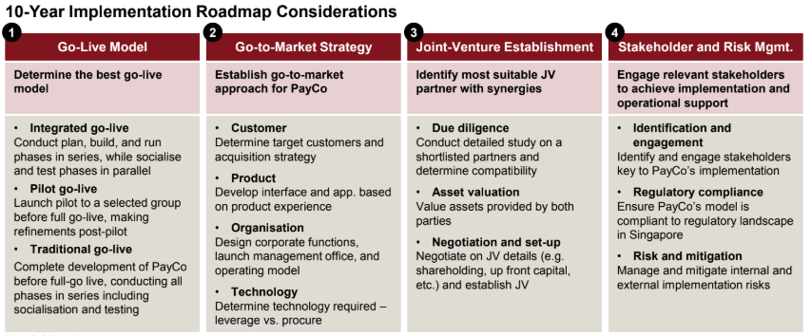
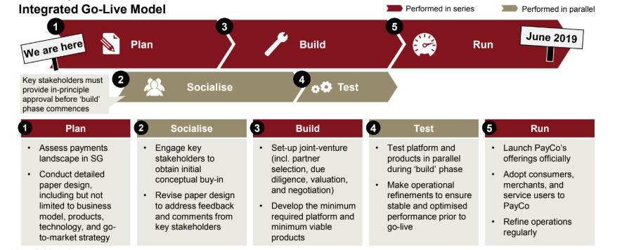
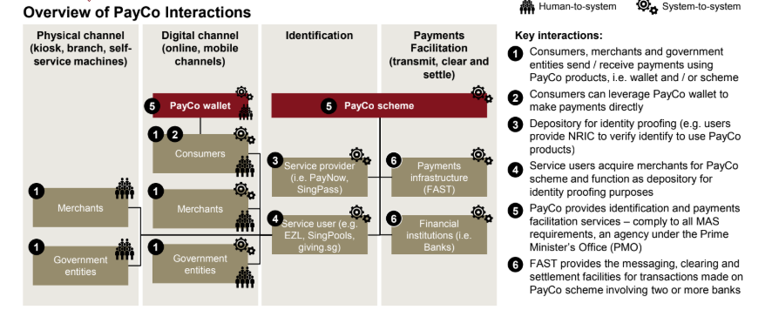
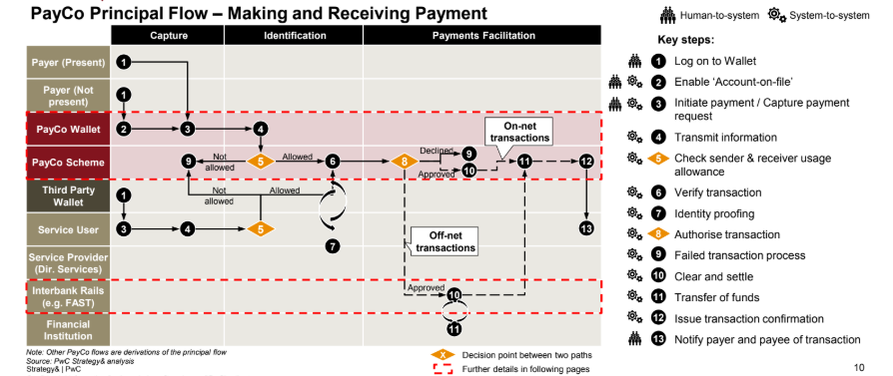
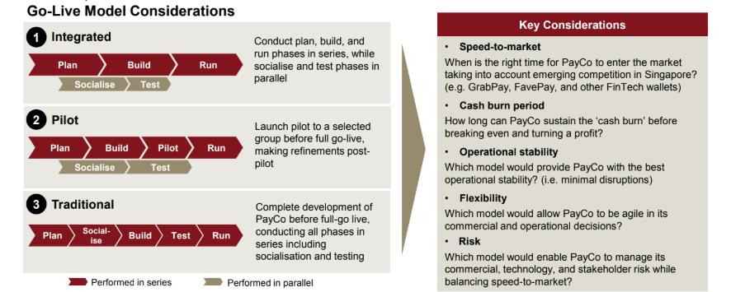

The high level technical architecture and implementation roadmap were developed to aid implementation of AgriCo
Overview of the Technical Architecture
Overview of the Implementation Roadmap
Key Takeaways
AgriCo services to include capturing produce orders, transmitting messages, and verifying and authenticating transactions to facilitating fulfilment and settlement
To capture produce orders, AgriCo will leverage on existing channels (i.e. mobile app) and greenfield (i.e. IoT sensors) in order to maximise affordability, availability, scalability and traceability
AgriCo will provide a seamless farm-to-table experience which includes human-to-system and system-to-system interaction
Key Takeaways
As a public infrastructure, an integrated go-live model was recommended for AgriCo as stakeholder socialisation and testing runs in parallel with the traditional plan, build and run
Go-live for AgriCo will be fast-to-market, potentially ahead of emerging AgriTech competition
Flexibility in making operational refinements
Support from key stakeholders in the early stages is crucial to ensure the success of AgriCo

Slide 22

Strategy Impact
© 2025 PwC. All rights reserved.
PwC refers to the PwC network and/or one or more of its member firms, each of which is a separate legal entity. Please see www.pwc.com/structure for further details.

